Slide 1



Teacher Notes:
This session explores whether our climate is changing and to what extent.
The pupils will learn about the difference between weather and climate.
The climate stripes will be introduced and the main drivers behind our changing climate.
The pupils will be presented with the data about climate change and the impact our food choices can play on this.

Slide 2

IS THE CLIMATE CHANGING?

Slide 3
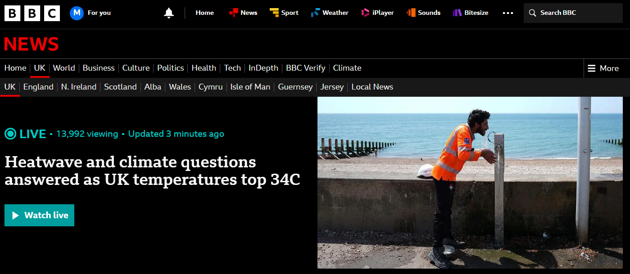
Is this an example of ‘climate change’?

Slide 4
WEATHER vs. CLIMATE?
First, we must define the difference between these two words.

Slide 5
WEATHER - what is happening right now
CLIMATE - the pattern of weather over a long time, typically 30 years

Slide 6
“It’s raining cats and dogs today!”
WEATHER or CLIMATE?

Slide 7
“It’s raining cats and dogs today!”
WEATHER or CLIMATE?

Slide 8
“Antarctica is usually
freezing cold and icy!”
WEATHER or CLIMATE?

Slide 9
“Antarctica is usually
freezing cold and icy!”
WEATHER or CLIMATE?

Slide 10
“We had a massive snowstorm last Tuesday”
WEATHER or CLIMATE?

Slide 11
“We had a massive snowstorm last Tuesday”
WEATHER or CLIMATE?

Slide 12
“Summers are getting hotter over the last 30 years”
WEATHER or CLIMATE?

Slide 13
“Summers are getting hotter over the last 30 years”
WEATHER or CLIMATE?

Slide 14
We can’t just look out of the window today and decide that the
climate is changing.
We have to look at the big picture of many years combined.

Slide 15
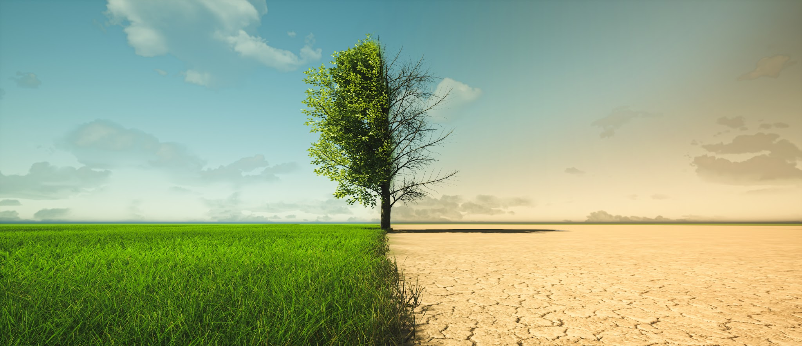

Slide 16
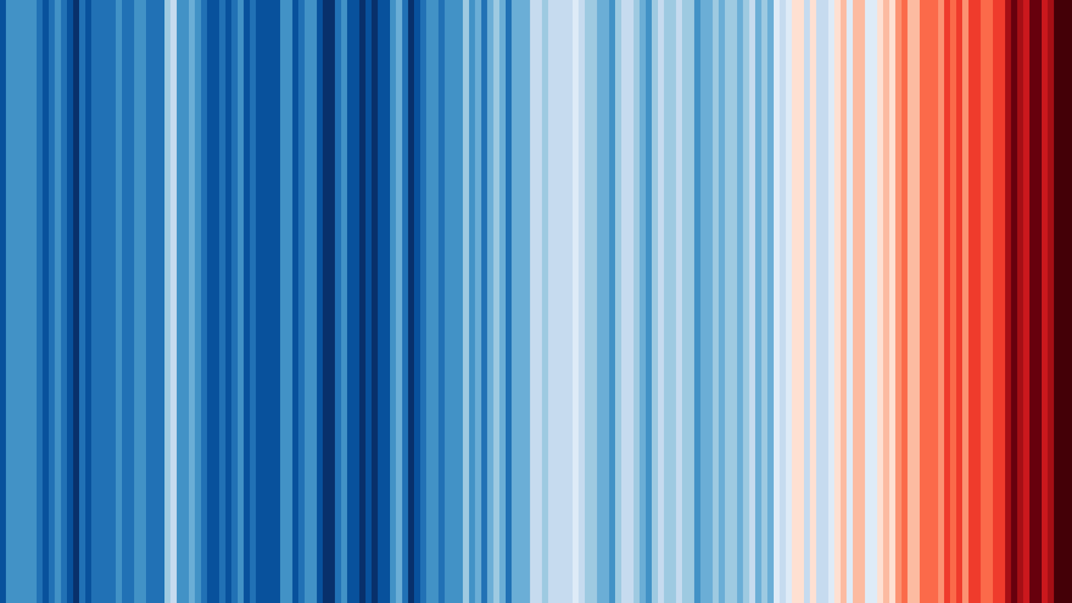
Do you know what these stripes represent?
https://showyourstripes.info/faq

Slide 17
The Earth's climate is changing rapidly, and the scientific evidence confirming this trend is unequivocal. While the Earth’s climate has gone through natural cycles of warming and cooling over billions of years, the current rate of change is unprecedented. It is occurring roughly 10 times faster than the average rate of warming observed after past ice ages.
https://science.nasa.gov/climate-change/evidence/

Slide 18
The blanket around the Earth that creates the natural greenhouse effect is getting too thick.
What do you think are the main causes?

Slide 19
The primary driver of climate change is human activity - predominantly the burning of fossil fuels and deforestation.

Slide 20
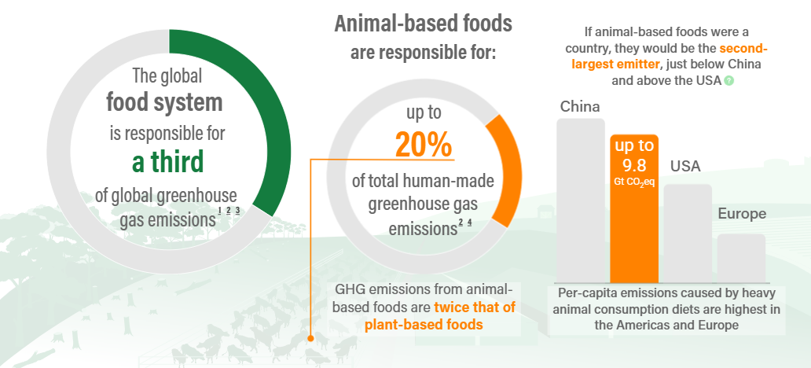
https://proveg.org/fsd-article/climate-change/

Slide 21
Plant-based diets have an up to 50% lower carbon footprint than current average diets.
Could you make small changes to the food you eat to have a big impact on climate change?
The climate is changing. Can you?
https://proveg.org/fsd-article/climate-change/

Slide 22
